Slide 1
The Scikit Learn Machine Learning Toolbox
Alexander Wendt

Slide 2
Motivation
Collect knowledge and good scripts in one place
Less Stack Overflow
Complete machine learning process with less customization
Not AutoML
Fast data analysis
Teach others

Slide 3
Research Question
How much manual customization can be reduced by using prepared scripts for common machine learning problems with structured datasets?

Slide 4
Methodology
Add all known preprocessing steps into scripts
Add all training algorithms and hyperparameter optimization steps into modular scripts
Add all graphics and evaluation into scripts
Idea: Better to reduce from script templates than writing new code

Slide 5
SKLearn Machine Learning Process
Github: https://github.com/alexanderwendt/sklearn_ml_toolbox
Main Blocks
Step 1: Gather raw data
Step 2: Generate features and outcomes
Step 3: Prepare and analyze data
Step 4: Get best hyperparameters
Step 5: Train model
Step 6: Evaluate model performance
Step 7: Infer new data

Slide 6
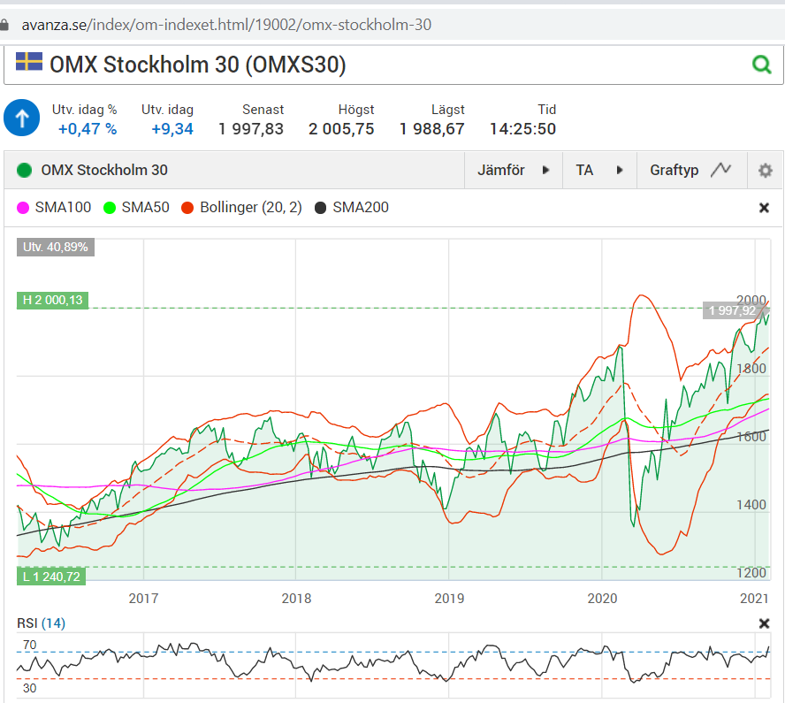
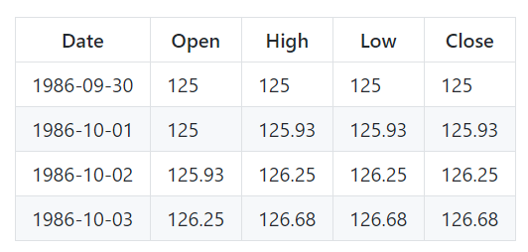
Step 1 – Get Raw Data
How good do technical indicators describe current stock market trend?
OMXS30 Index from http://www.nasdaqomxnordic.com

Slide 7
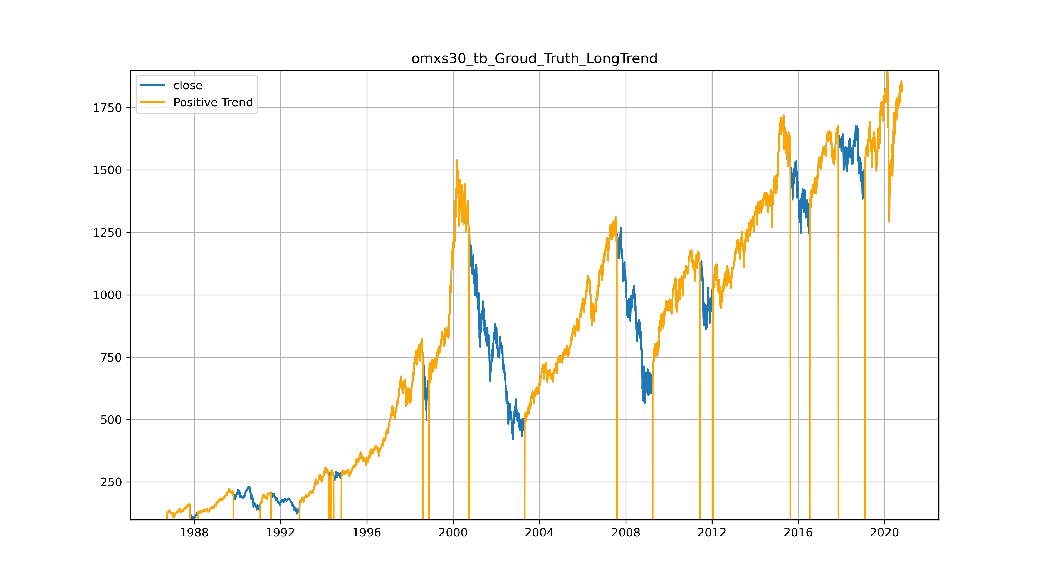
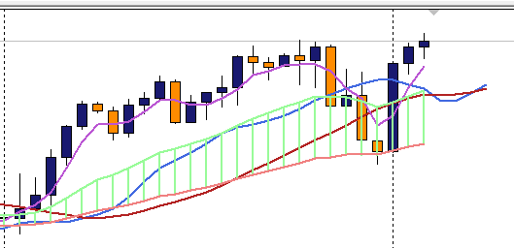
Step 2 – Generate Features and Outcomes
Time series
Technical indicators capture history
Moving Averages
Oscillators

Slide 8
Step 3 – Data Cleaning and Adaptation
Cleaning
Column names are stripped
" " are replaced by "_" to get unified naming
"/" are replaced by "-"
All string values "?" or empty values are replaced by numpy "NaN"
Adaptation
Binarize Labels: One vs. All
Nominals: One-hot-encoding
All to int or float

Slide 9
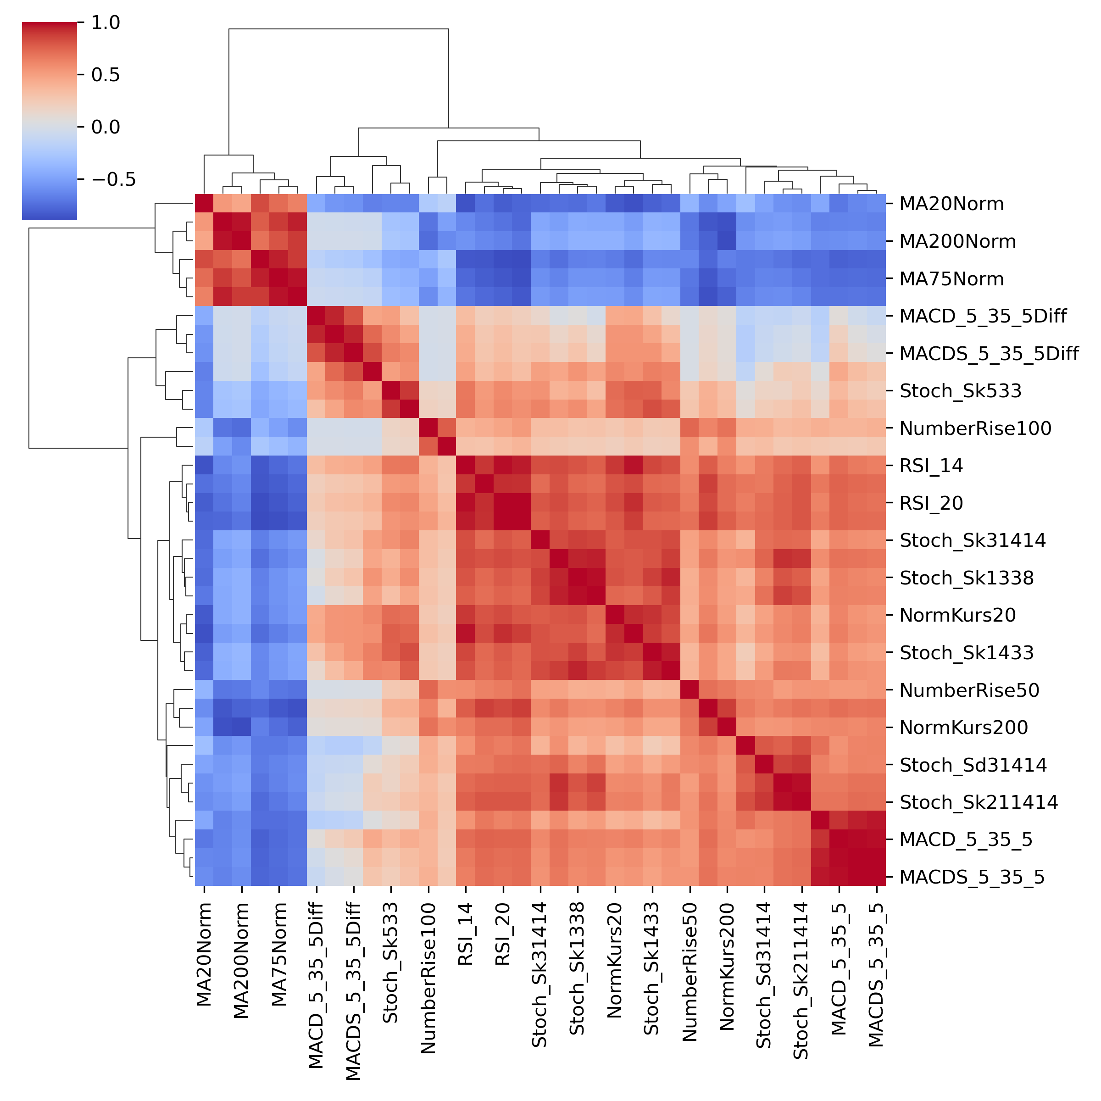
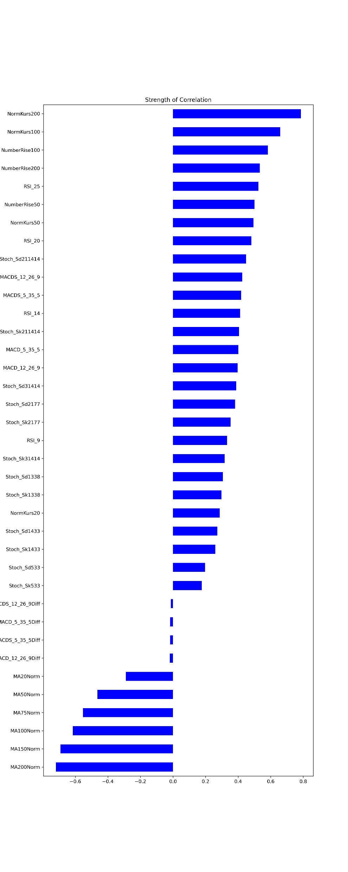
Step 3 – Data Analysis 1
Hierarchical Linkage
Feature Importance
Visual correlation analysis
See important features

Slide 10
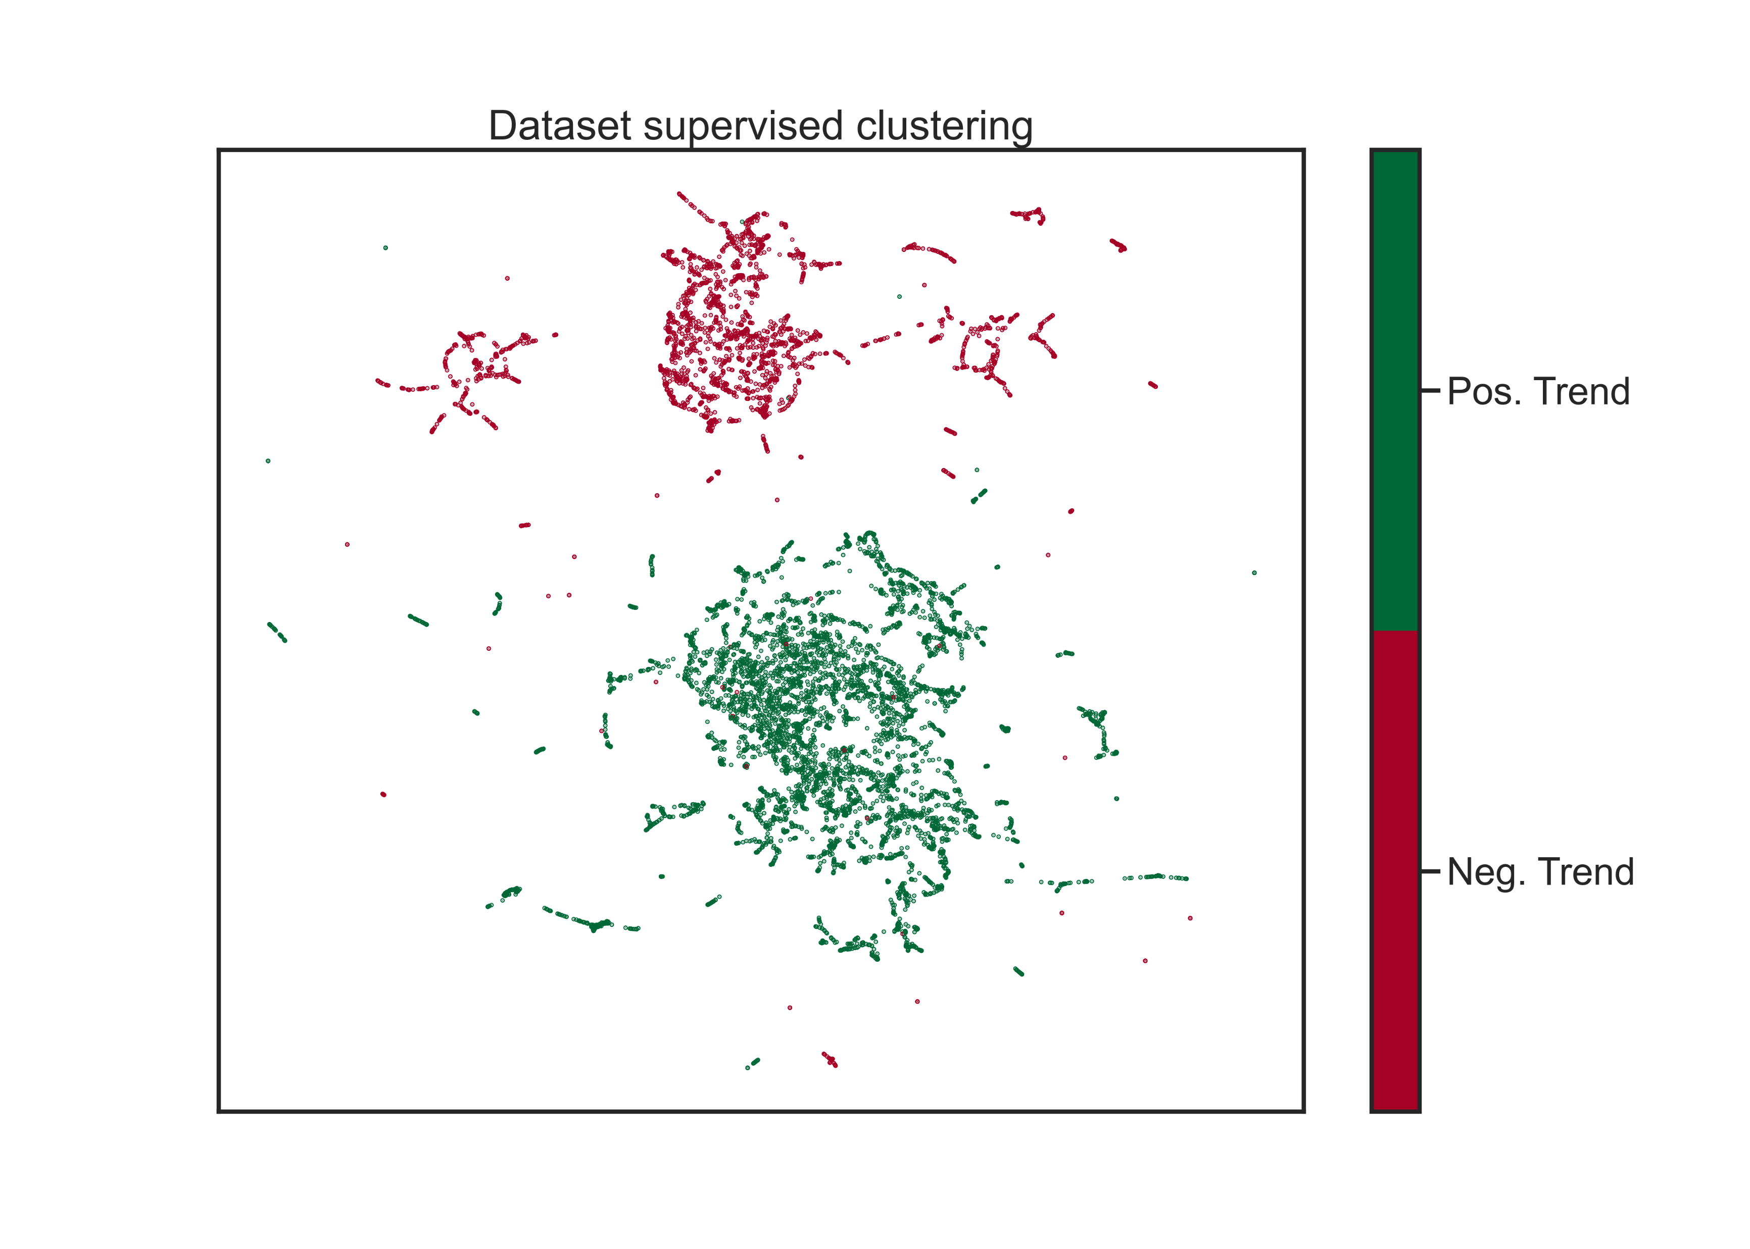
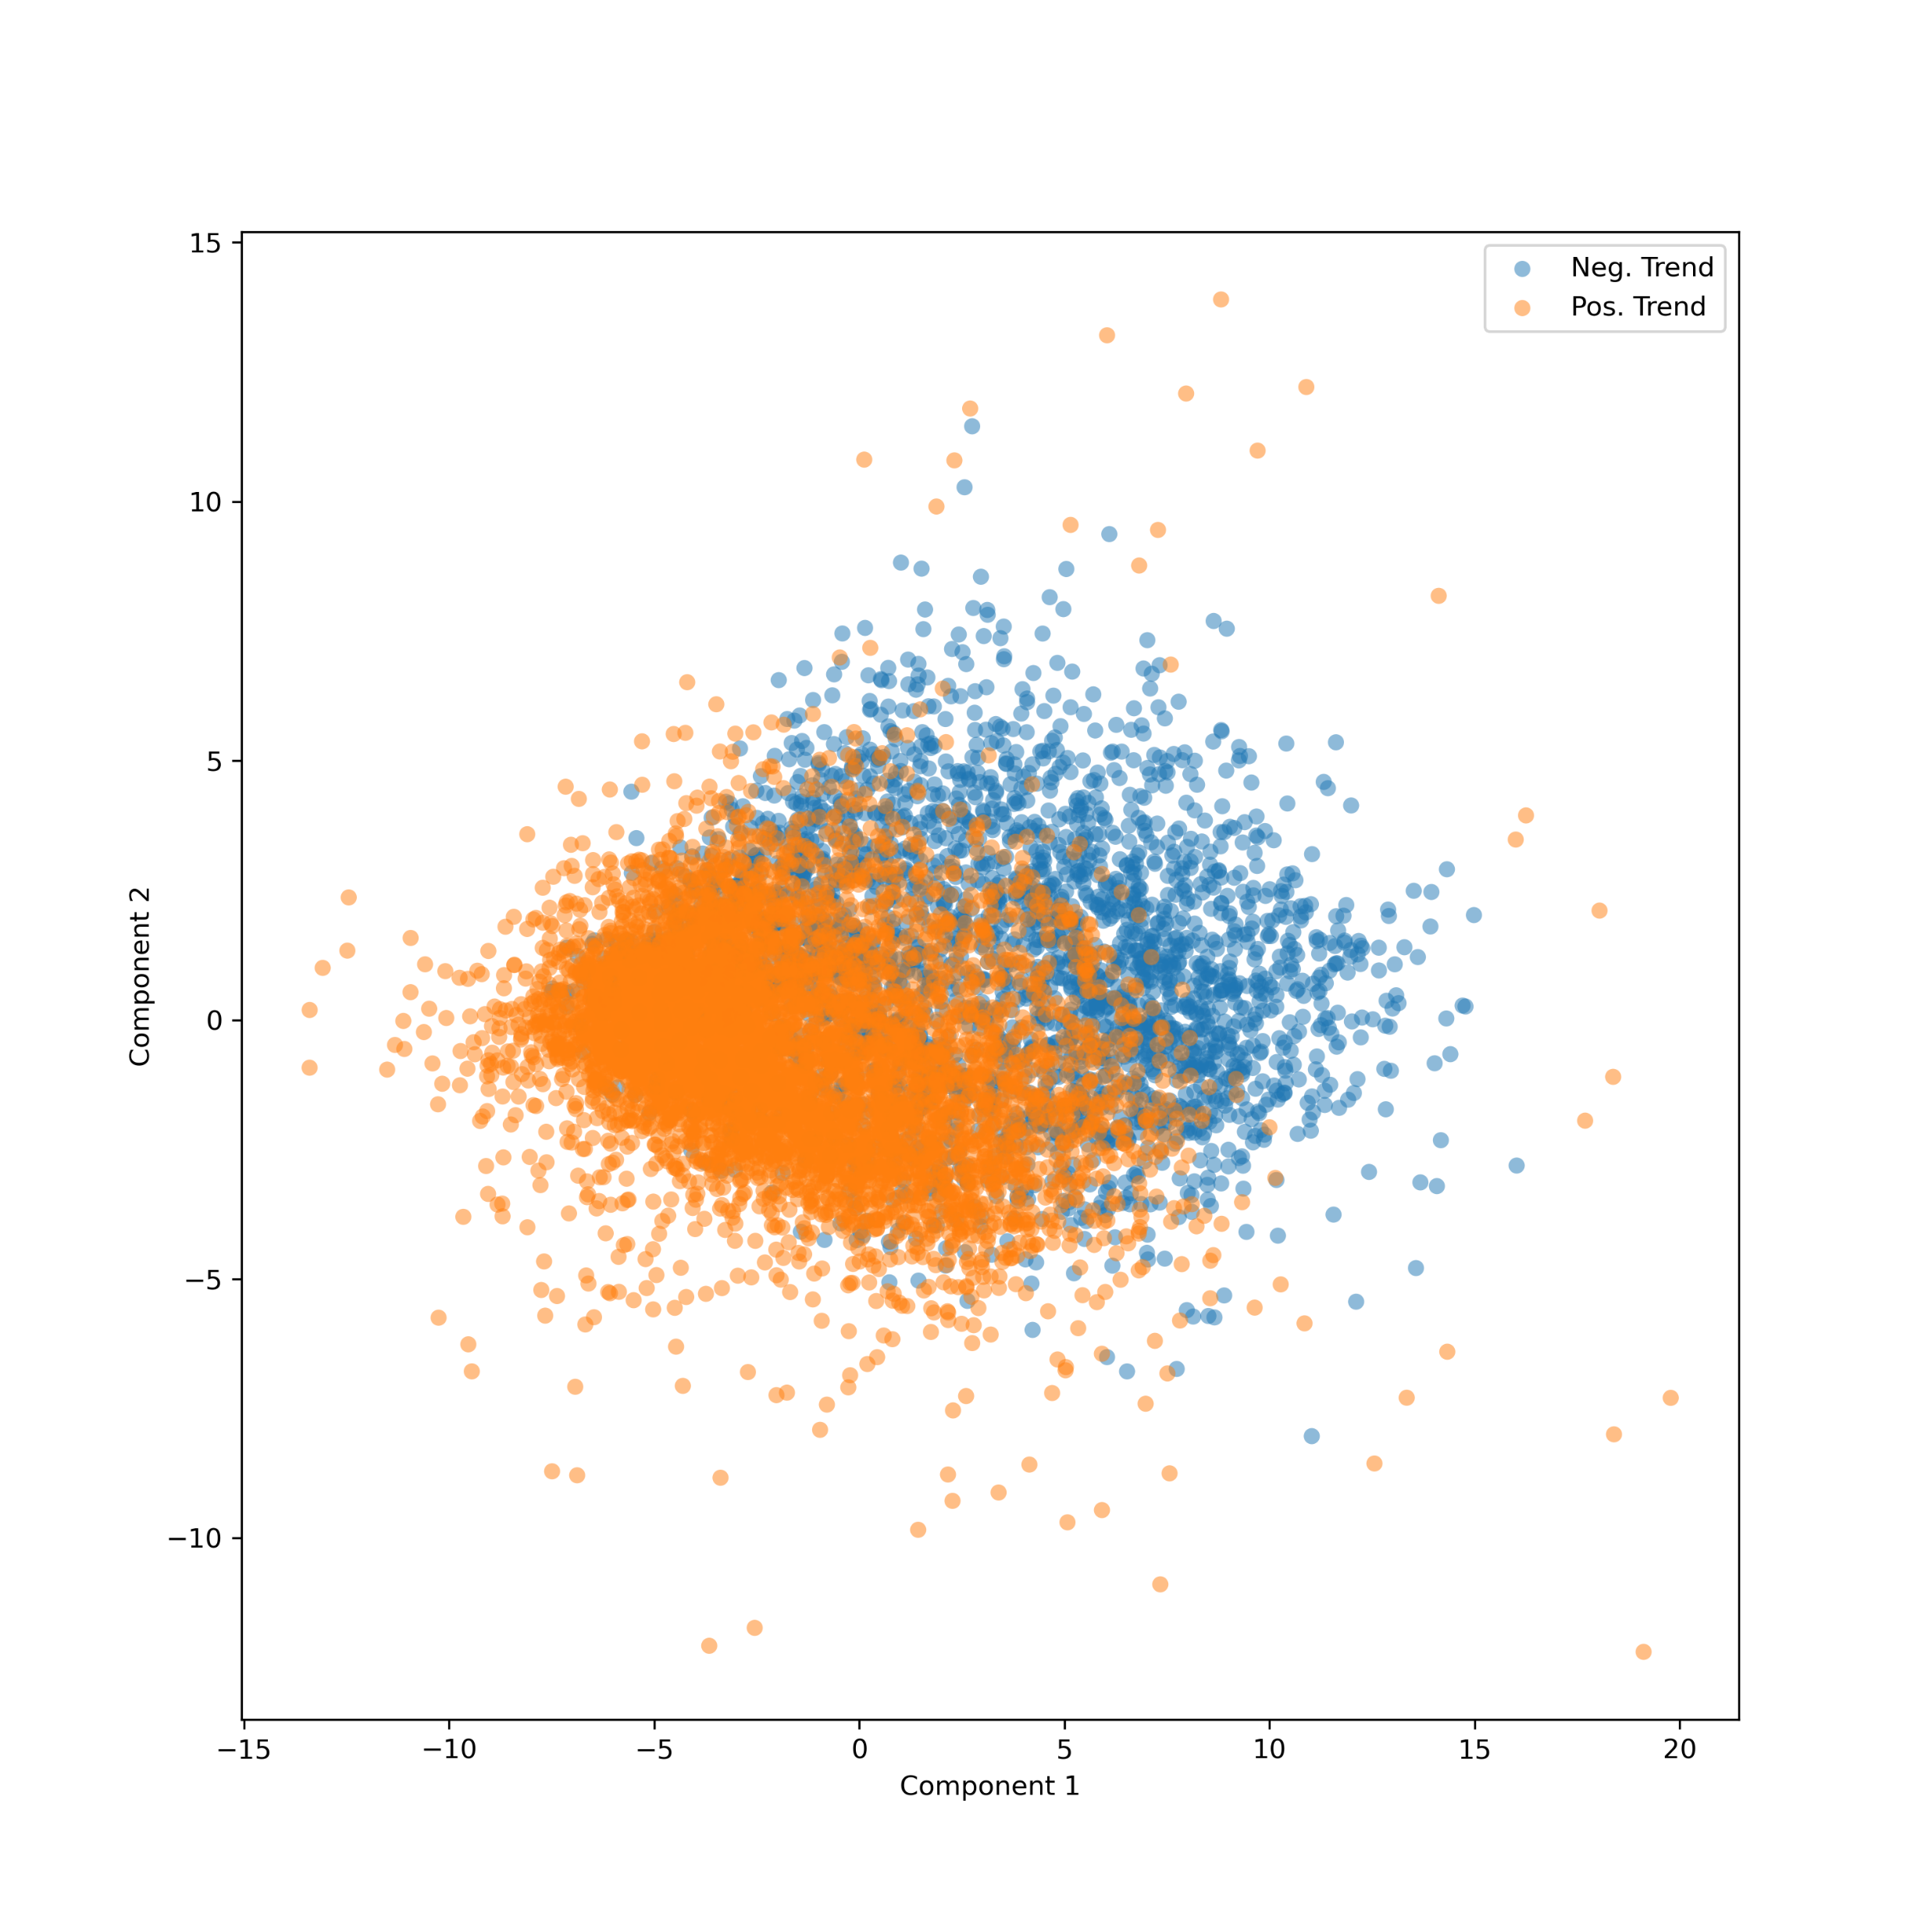
Step 3 – Data Analysis 2
Supervised UMAP
Cluster analysis
Unsupervised: Prinipal Component Analysis (PCA)
UMAP
See how well data can be grouped
PCA

Slide 11
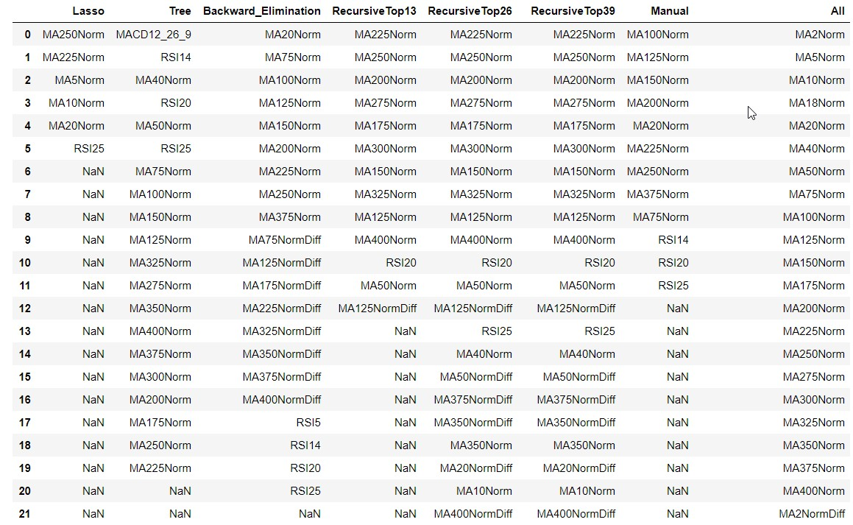
Step 3 – Feature Selection
Remove low correlated features
Purpose
Make faster models (SVM max 80 features)
Remove noise
Sometimes get better results

Slide 12
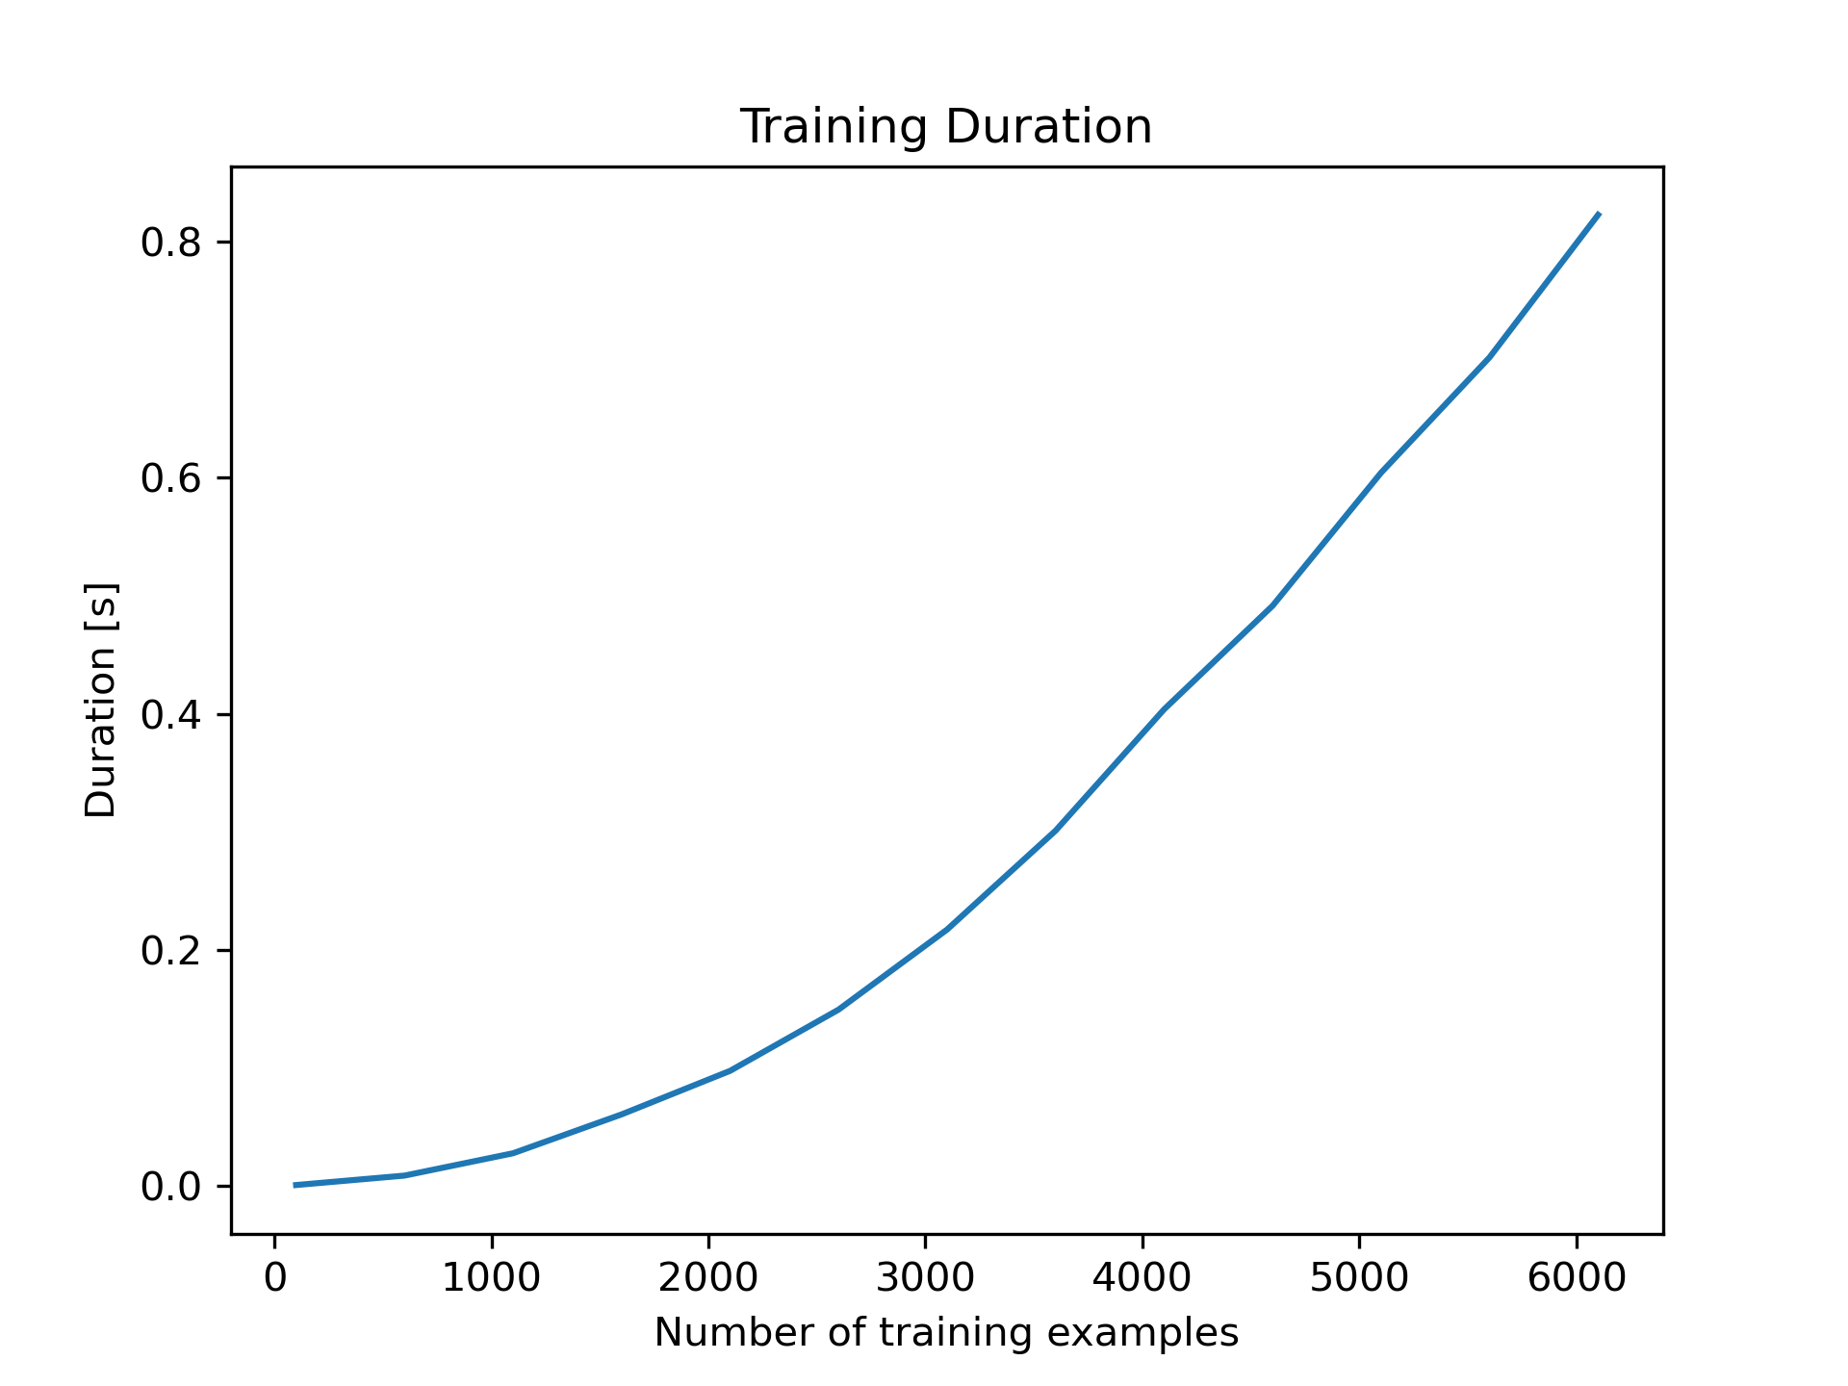
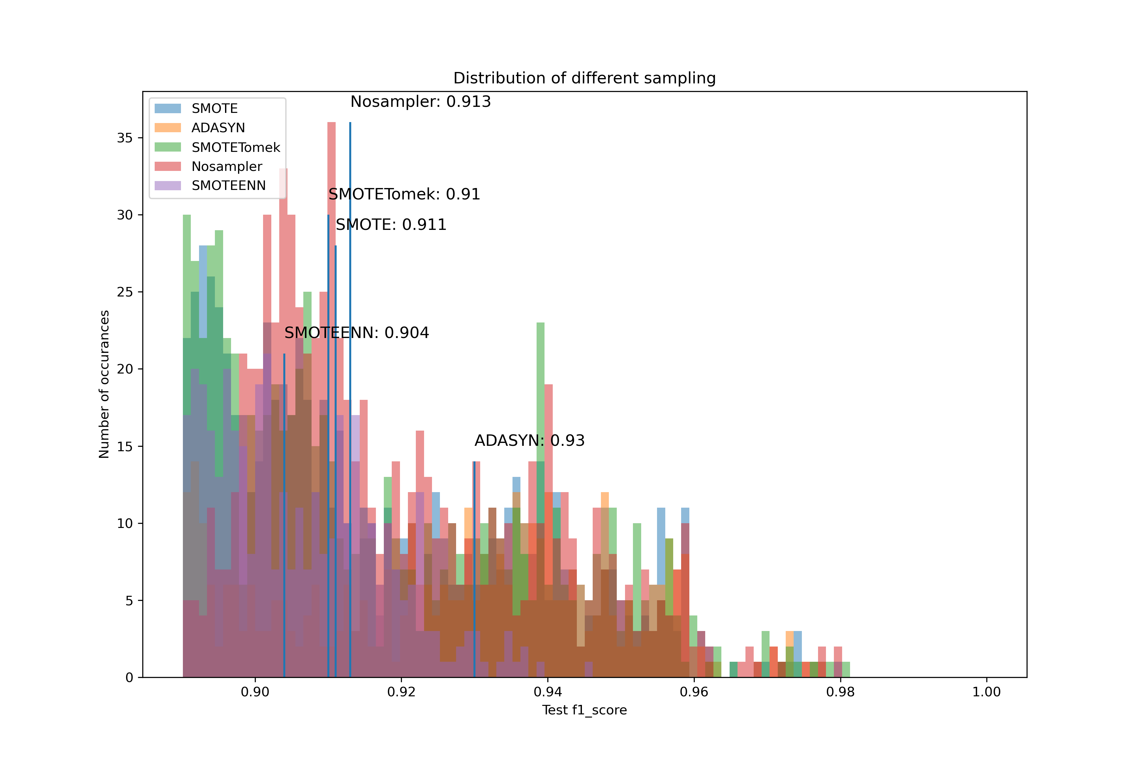
Step 4 – Find Best Hyperparameters Phase 1
SVM
Two Phase Hyperparameter Search*
Phase 1: Determine discrete values with less data
*Wendt, A., Wuschnig, M., Lechner M.: Speeding up Common Hyperparameter Optimization Methods by a Two-Phase-Search. In proceedings of IECON 46th Annual Conference of the IEEE Industrial Electronics Society (IES), 2020, Singapore (online), ISBN: 978-1-7281-5413-8/20, pp. 517-522, 2020

Slide 13
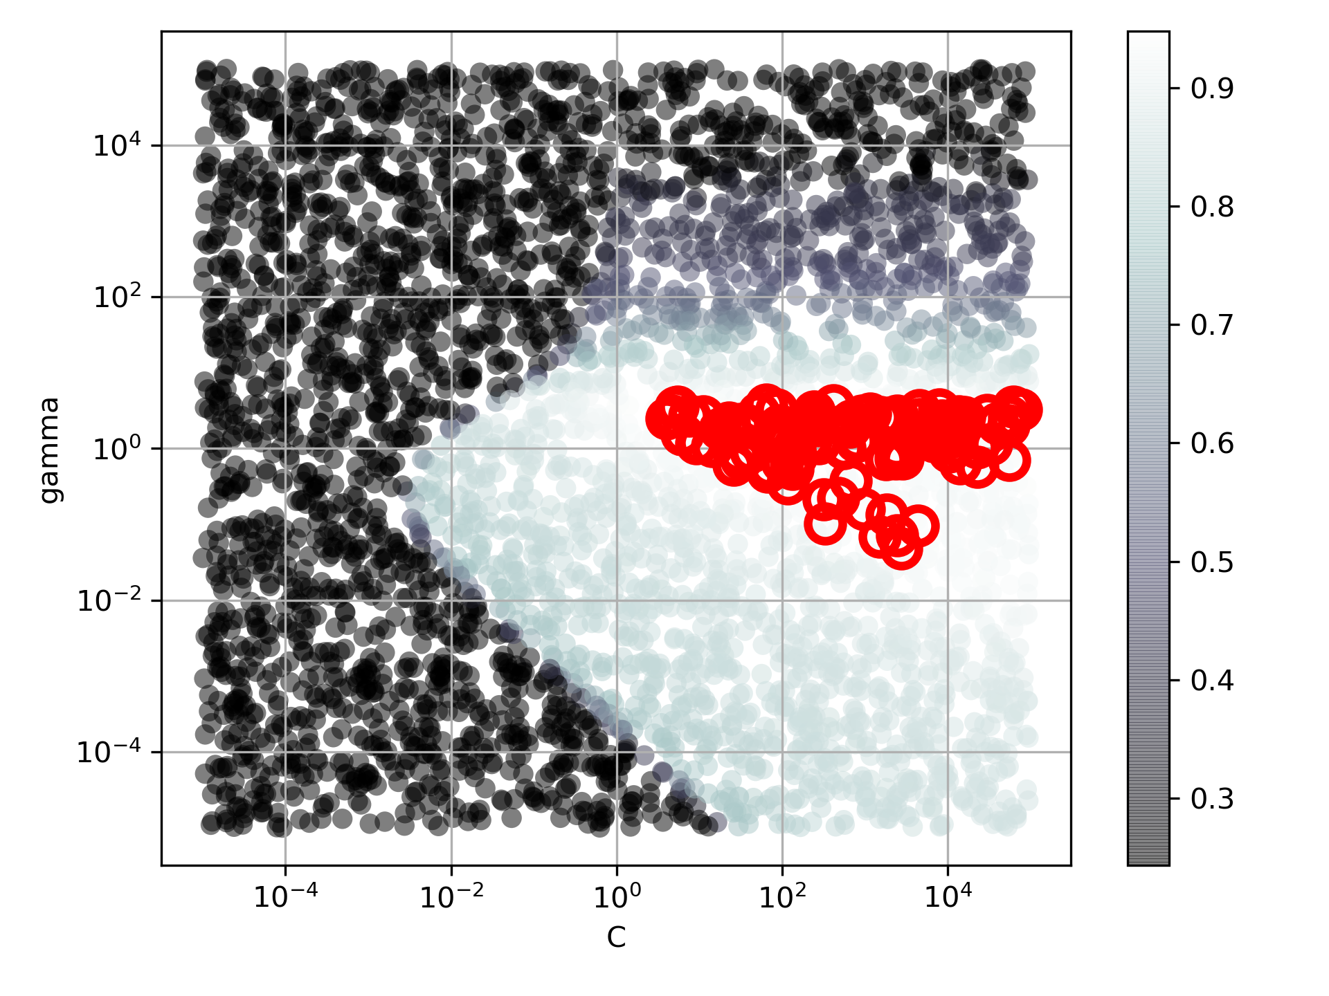
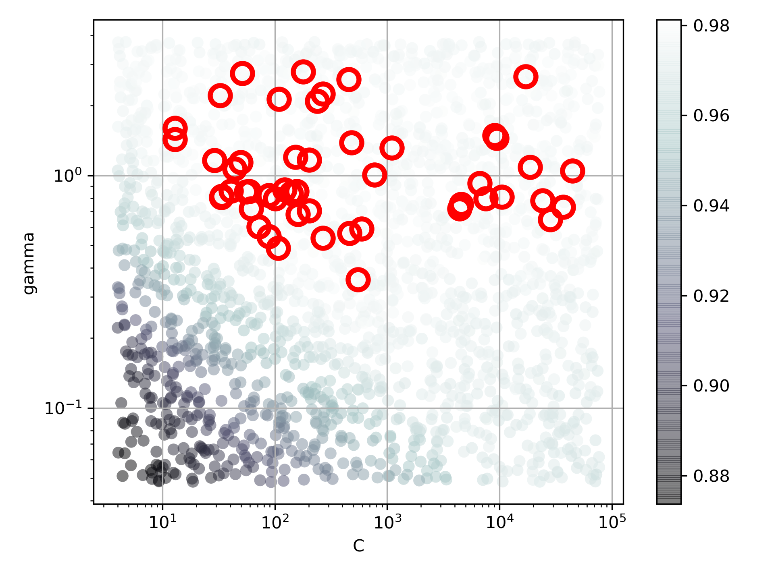
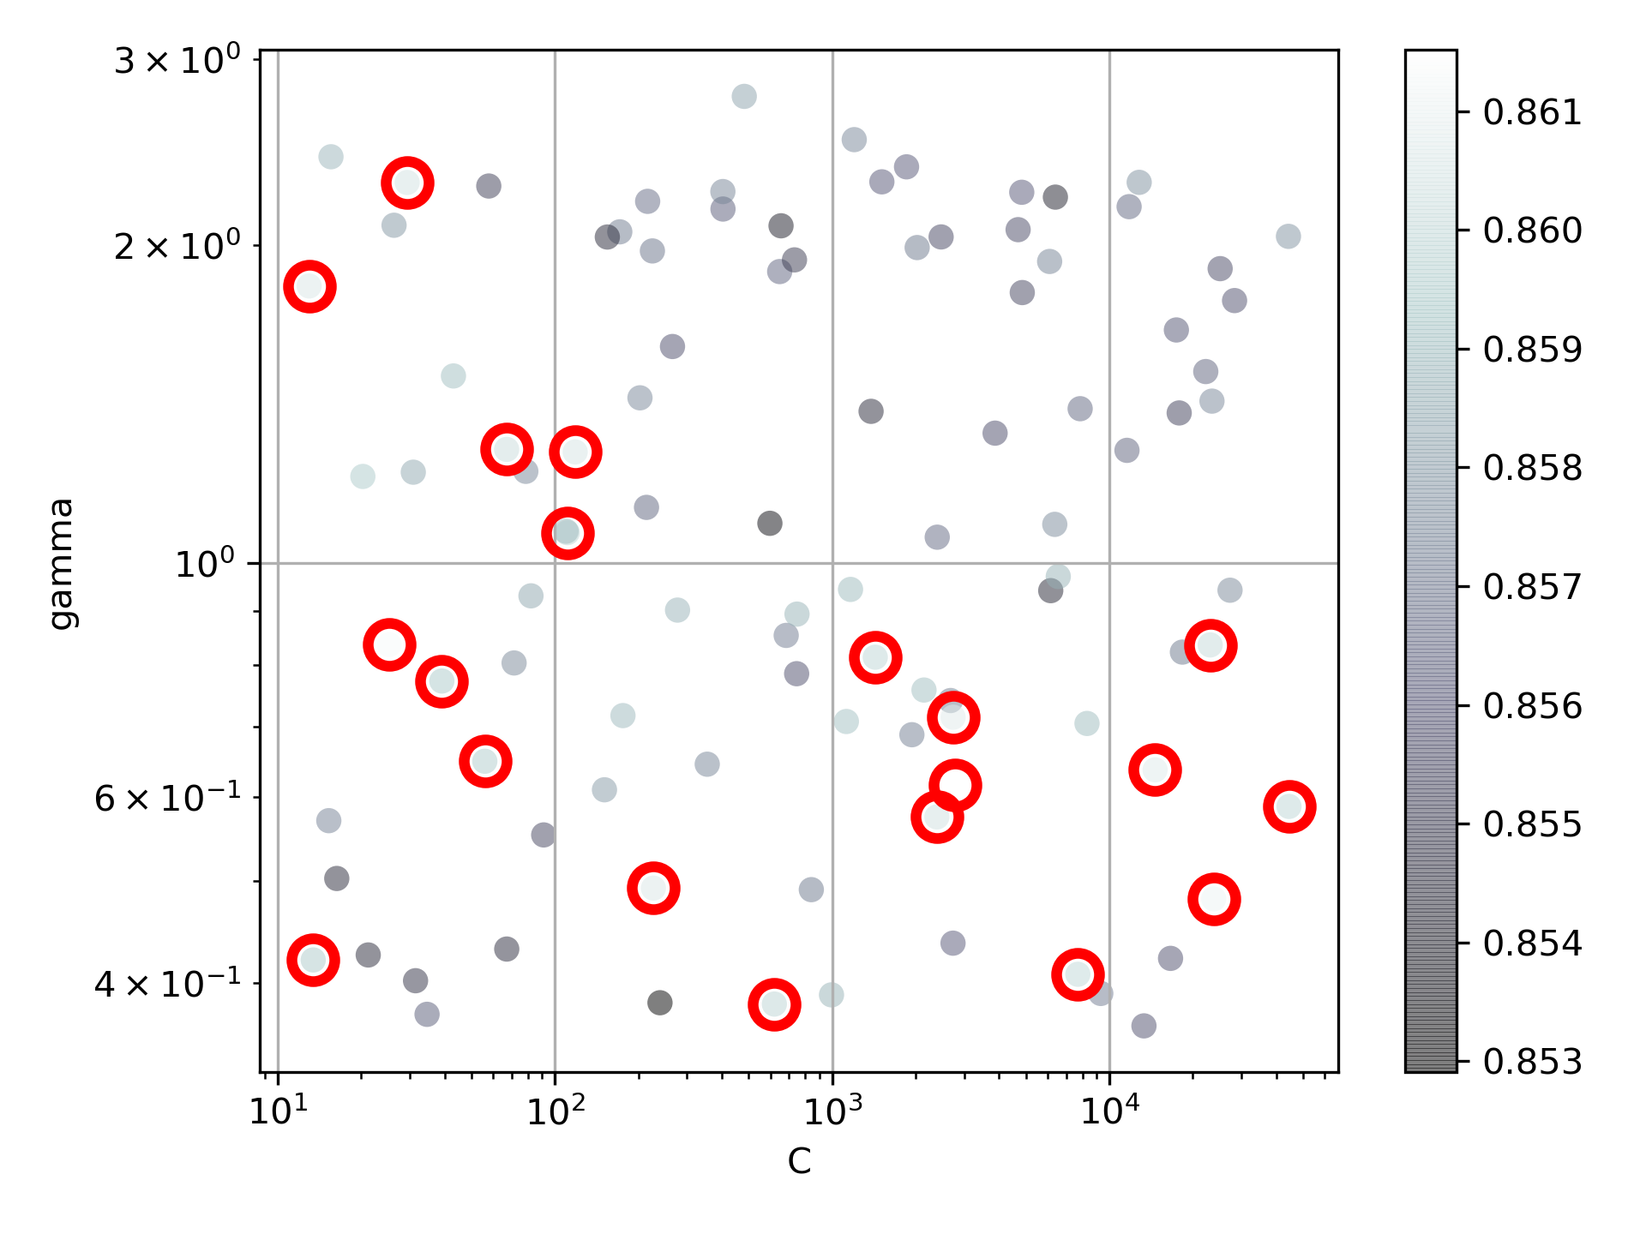
Step 4 – Find Best Hyperparameters Phase 2
More data, narrow range
SVM: C and gamma
Samples: 20%
Iterations: 4000
Top Selection: 100
Samples: 40%
Iterations: 2000
Top Selection: 50
Samples: 100%
Iterations: 100
Top Selection: 20

Slide 14
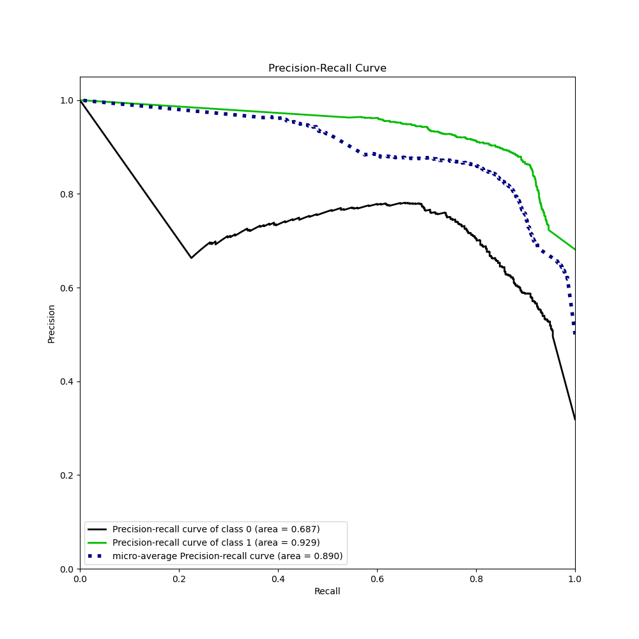
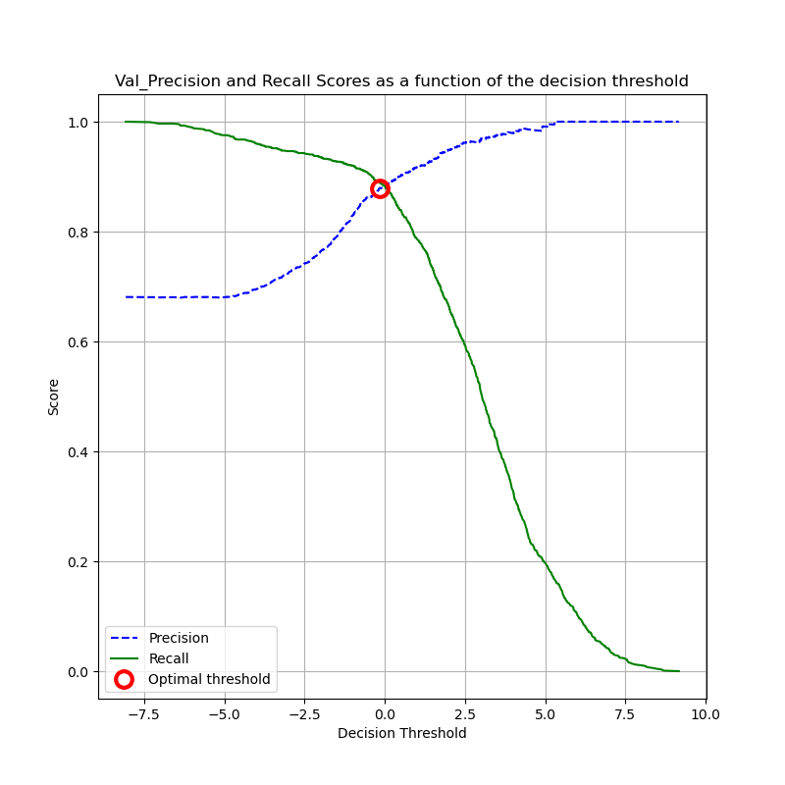
Step 4 – Find Precision Recall Threshold

Slide 15
Step 5 – Train Model
Best pipe:
Pipeline(steps=[
('scaler', QuantileTransformer()),
('sampling', ADASYN()),
('feat‘, ColumnExtractor(cols=[1, 2, 3, 4, 5, 6, 7, 8, 9, 10, 11, 12,
14, 15, 16, 23, 24, 25, 26, 28, 29, 30,
31, 32, 34])),
('svm', SVC(C=2786.3123139377217,gamma=0.6169115526350926))
])

Slide 16
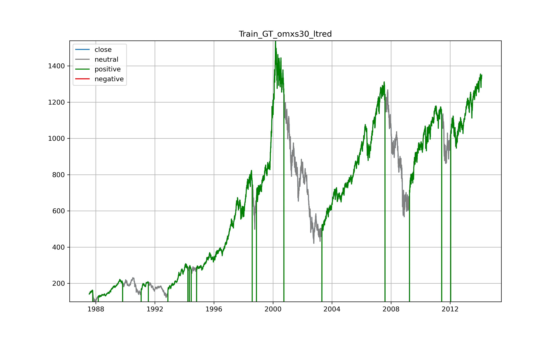

Step 6 – Evaluate on Training Data
Almost perfect fit -> Overfitting?

Slide 17
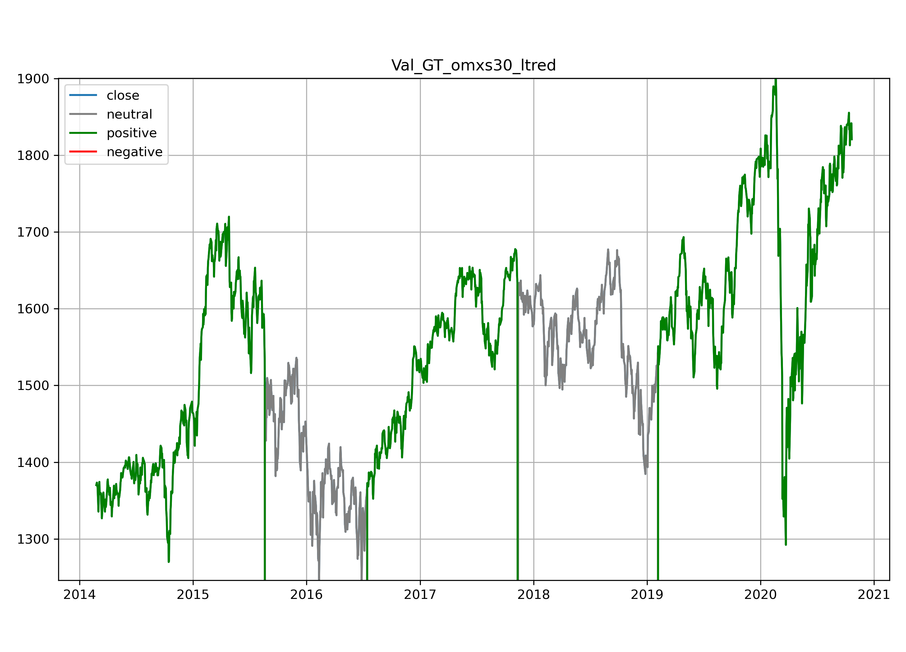
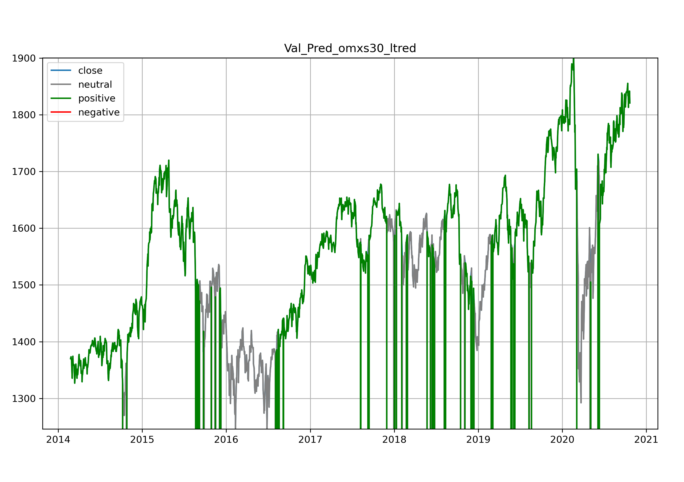
Step 6 – Evaluate on Validation Data
Can you make money with this information?
Need additional filter
Corona

Slide 18
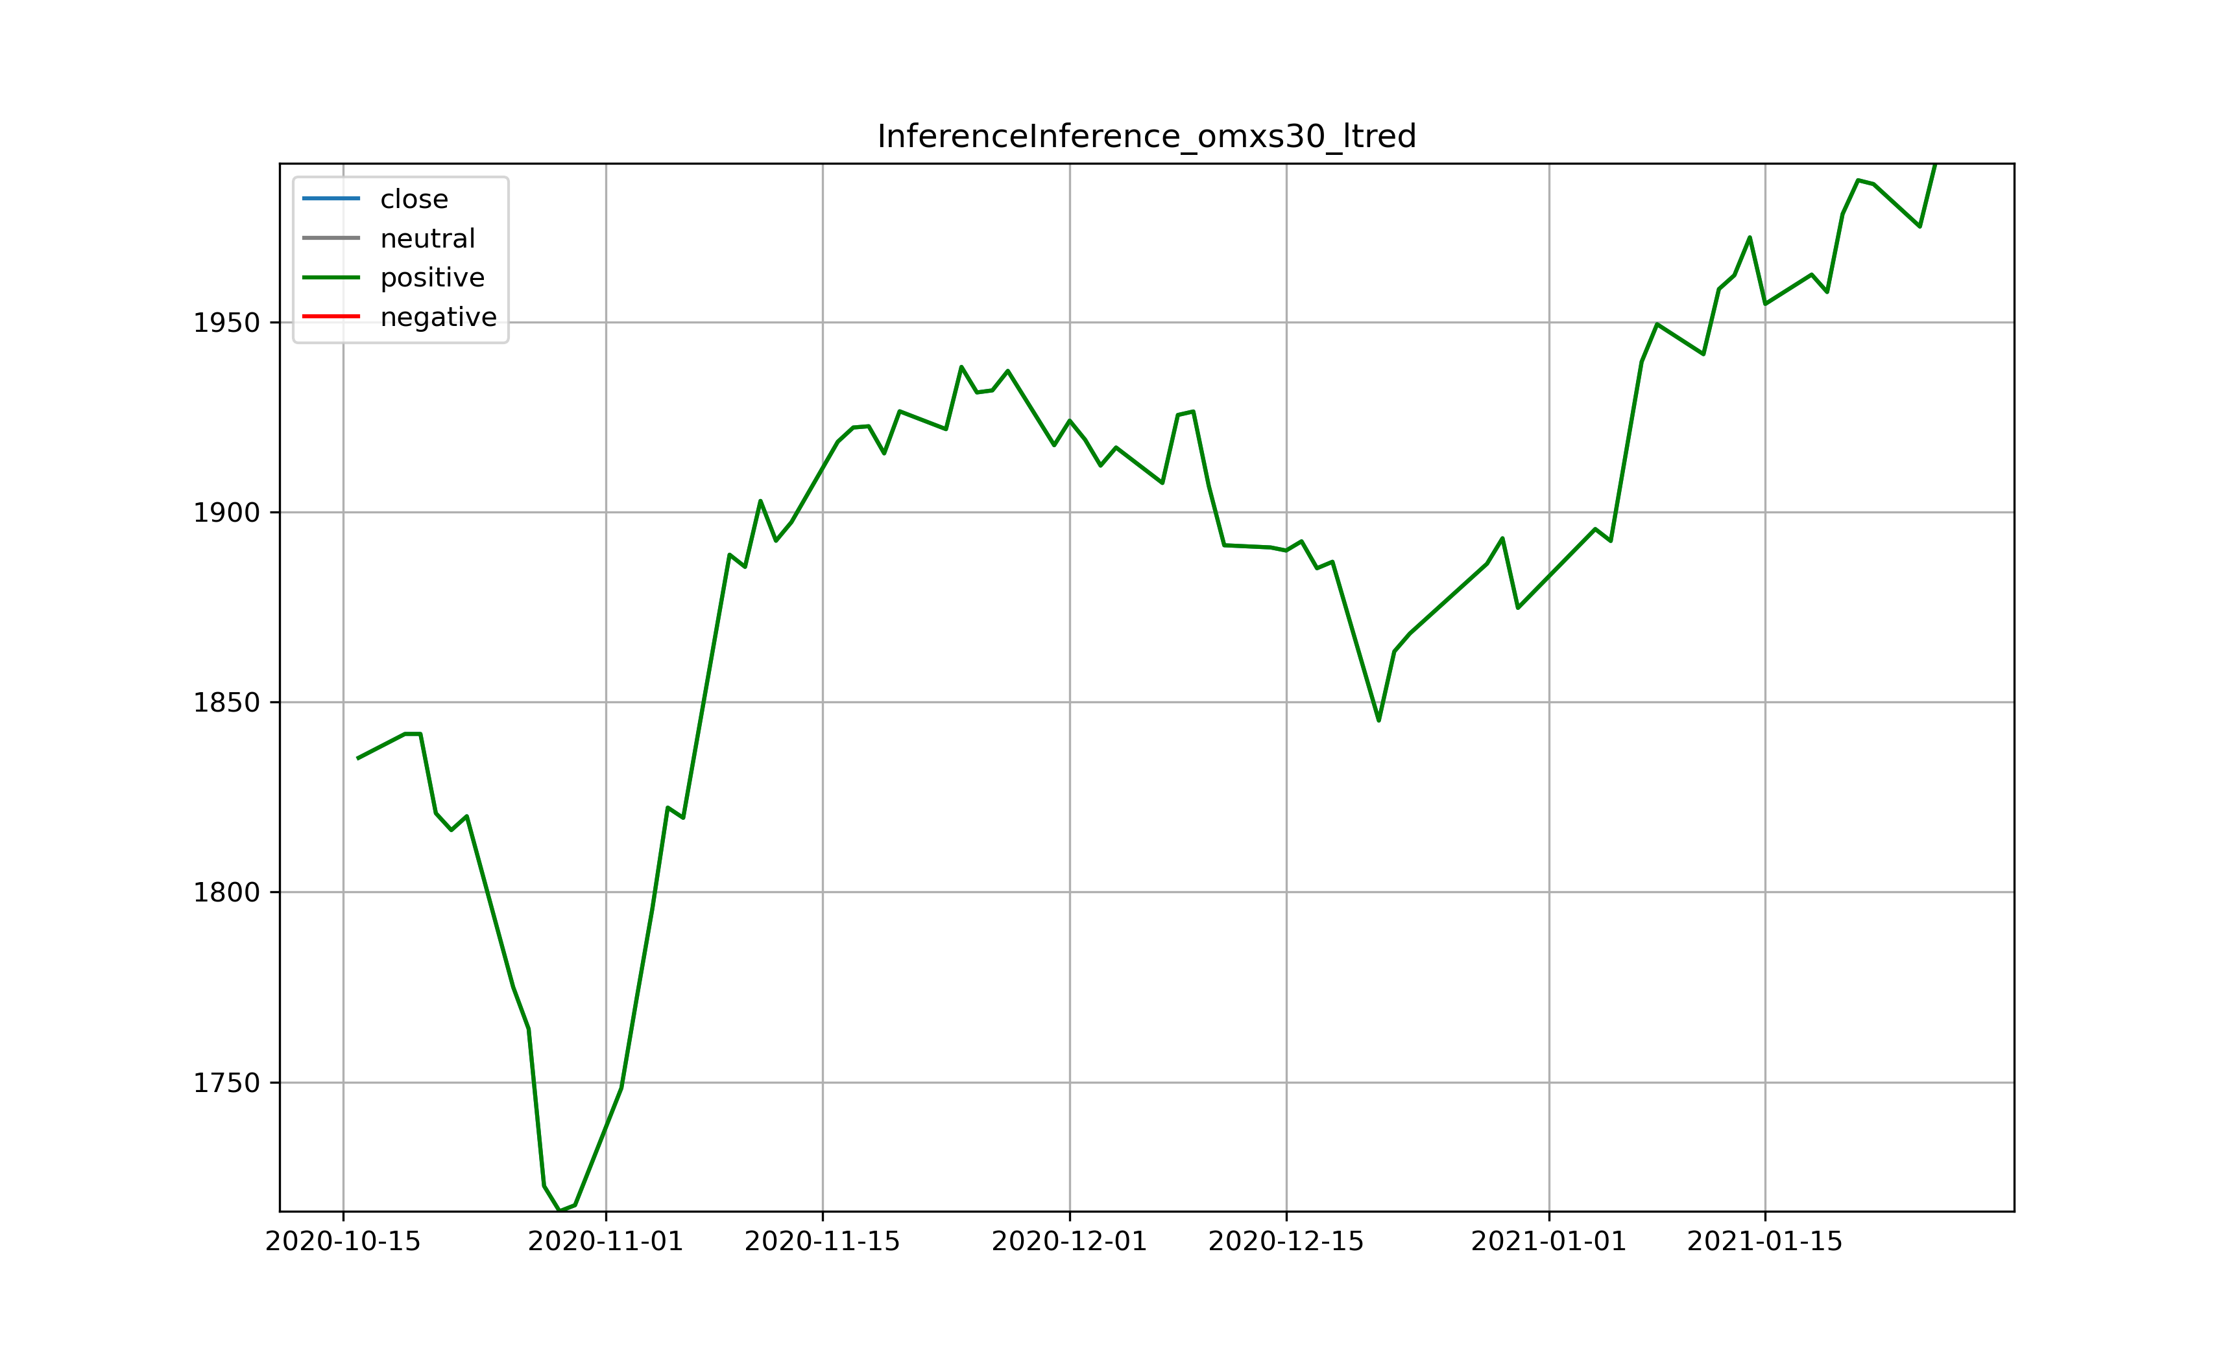
Step 7 - Prediction
Still positive trend!
Watch out for false positives
Professionals say: „5 months after a major bull top, you can recognize it“
Consider other indicators: Bitcoin, GameStop and Tesla -> increased risk

Slide 19
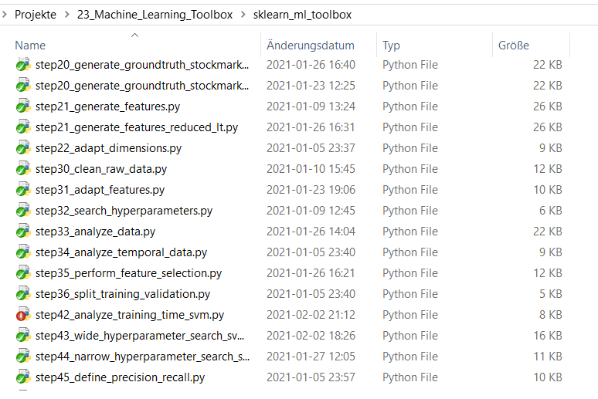
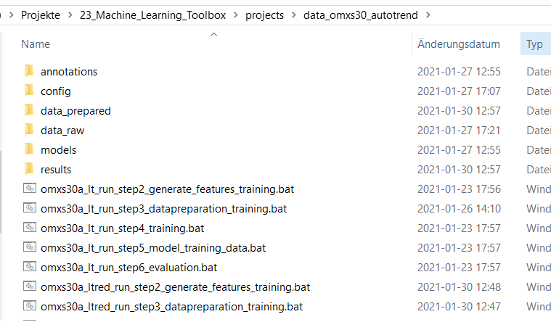
Efficient Coding – Also for EML
Source Code from Git
Project instance

Slide 20
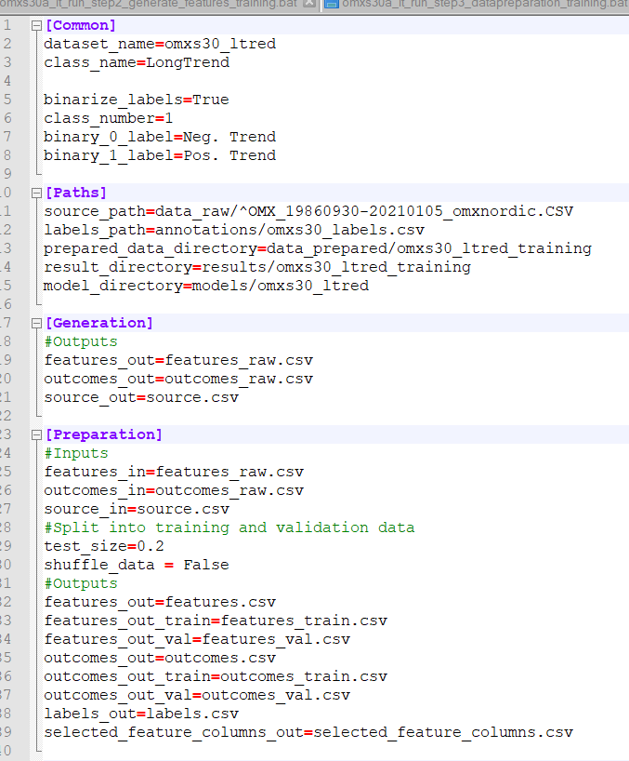
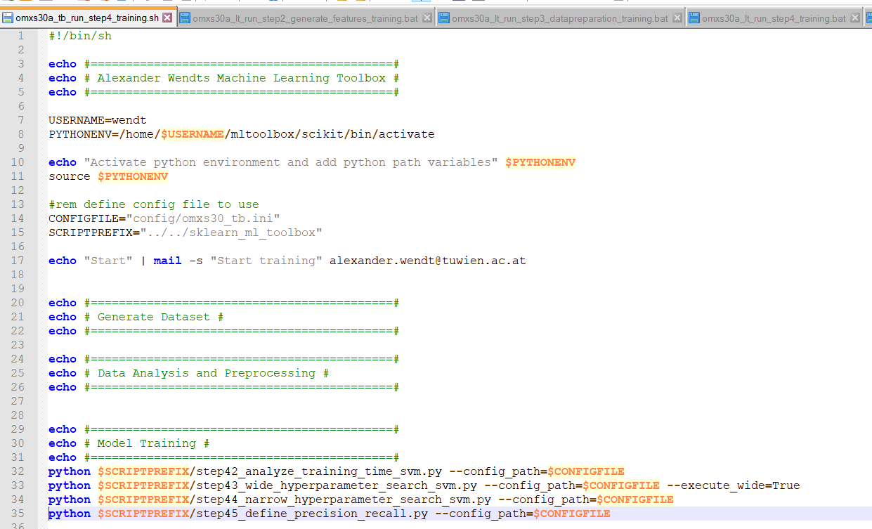
Efficient Coding – bat/sh

Slide 21
Conclusion
Huge effort reduction for similar datasets and reproducibility
…but each dataset is unique
Know your code
Know your data
Script templates for CDLEML
Stock market: Extremely hard to make money with machine learning

Slide 22
EML Toolbox Preparations

Slide 23
Thank you for your attention!

Slide 24
Extra Slides

